Slide 1

Computer Vision & Pretrained Models
13 Aug
2026
AI Summer Training Course - Level 2
Presented to you by: Mahmoud Sayed
AI and Machine Learning Track

Slide 2
Course Content
01. Quick review of neural network concepts
02. Common Computer Vision Tasks
03. CNN architectures, Convolution layers and filters
04. Image preprocessing and augmentation
05. Training, validation and evaluation for image classification
06. Why pretrained models are used in real computer vision projects
07. Transfer learning workflow and freezing and unfreezing layers
08. Common pretrained model families
09. Saving and reusing trained models

Slide 3
What is Computer Vision
Computer vision is the field of computer science and artificial intelligence concerned with enabling computers to acquire, process, analyze, and understand visual information from the world.
Computer Vision has many applications such as:
Black Box

Slide 4
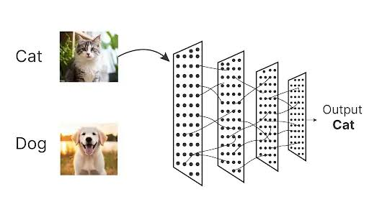
Image Classification
Black Box

Slide 5
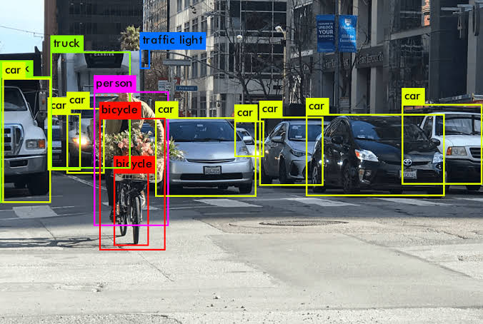
Object Detection
Black Box

Slide 6
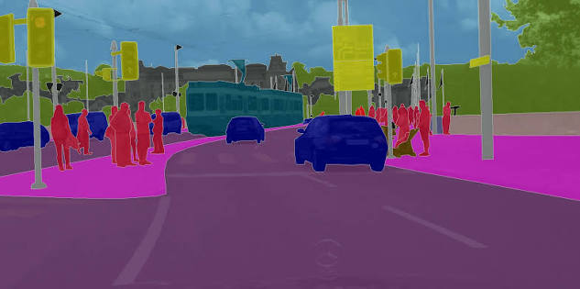
Segmentation
Black Box

Slide 7
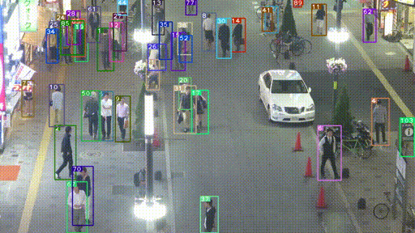
Object Tracking
Black Box

Slide 8
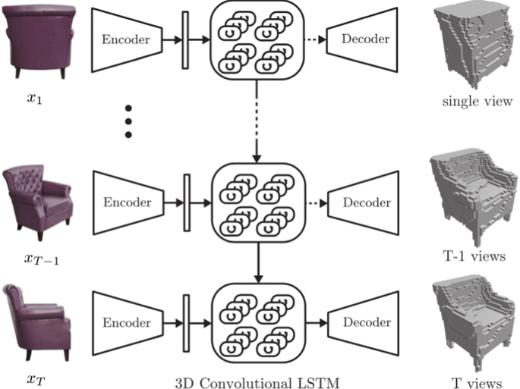
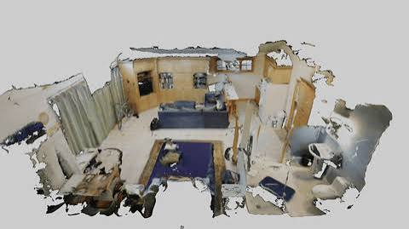
3D Reconstruction
Black Box

Slide 9
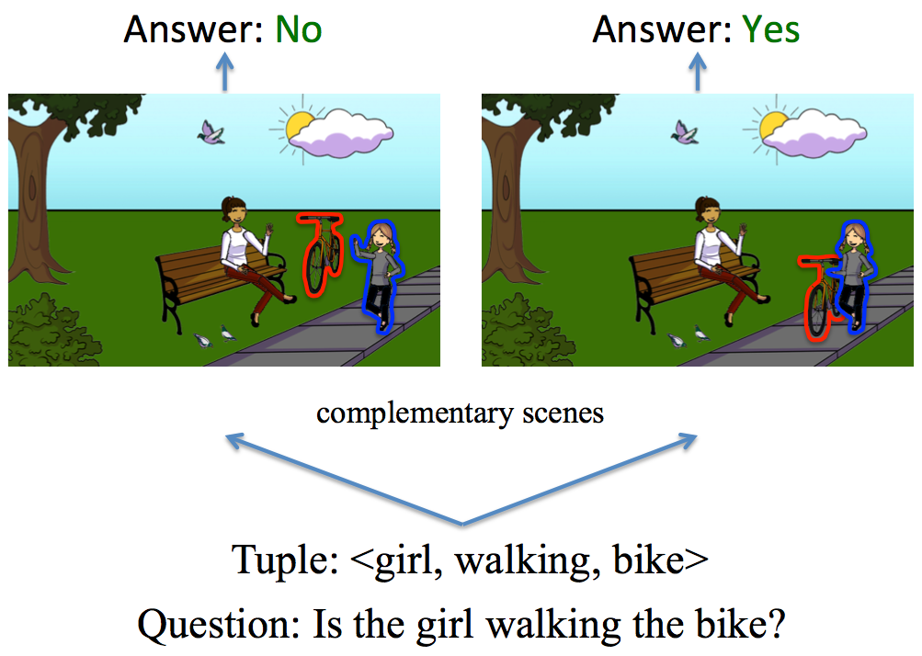
Visual Question Answering (VQA), overlaps with NLP
Black Box

Slide 10

Image Generation
Black Box

Slide 11
Countless Other Applications
Black Box

Slide 12
Let’s step back a little bit though
Black Box

Slide 13
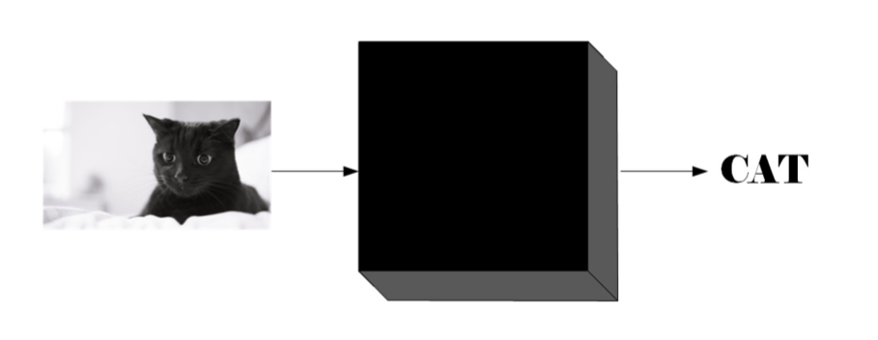
Neural Netowrks Concepts
What’s a Neural Netowrk?
Let’s think of a neural network as a black box that takes some input, does some unknown processing, then produces an output.
Black Box

Slide 14
The Black Box Internals
A Vanilla Neural Networ typically consists of:
Input/s
Weights
Neurons
Activation function / Non-Linearity
Output/s
Black Box

Slide 15
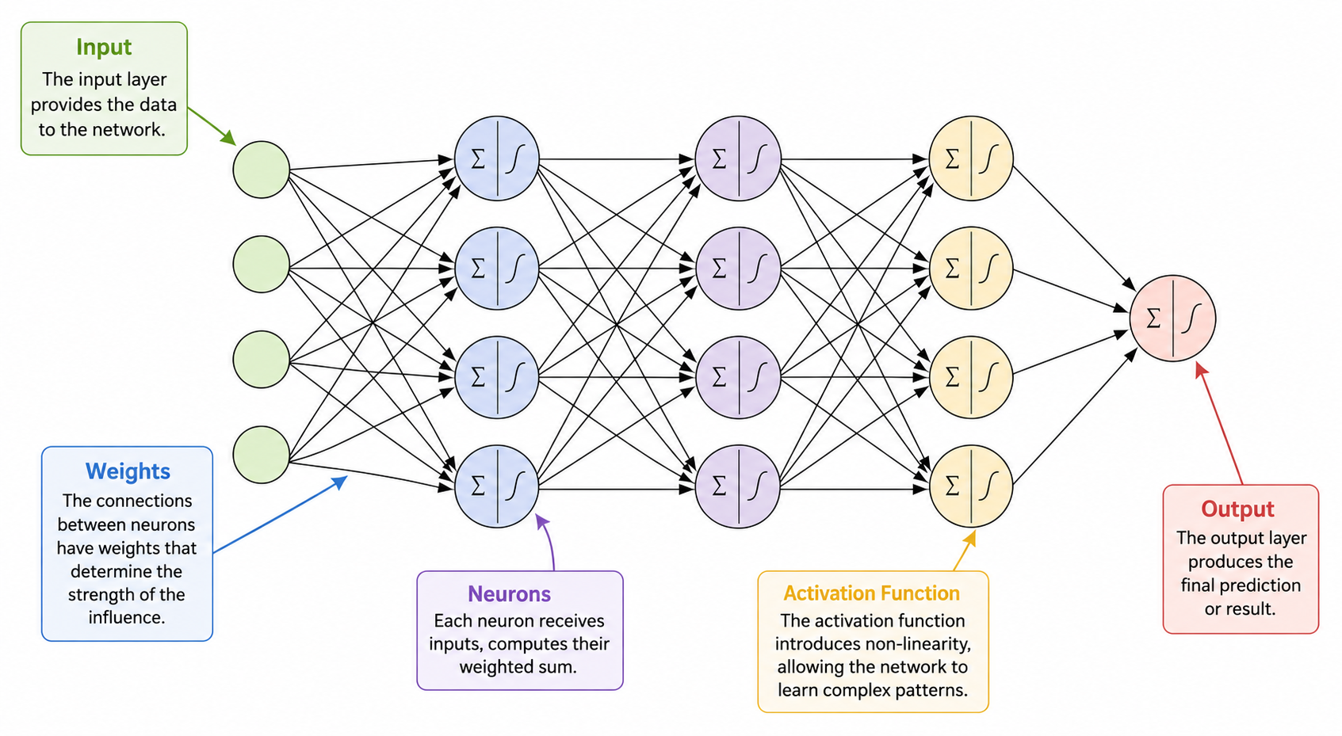

Slide 16
Neural Network Weights
The weights/parameters of a neural network are represented as matrices
They’re randomly initialized at the beginning.
As the network trains using Backpropagaion and update steps, the weights start converging to more meaningful values [to the network, hardly to us], that extract meaningful information from the input.
Black Box

Slide 17
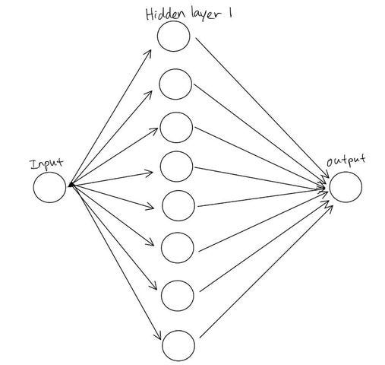
Universal Function Approximation Theorem
Let’s step back a little bit.
The idea of Neural Networks emerged from the Universal Function Approximation Theorem (UFAT)
UFAT states that A feedforward neural network with a single hidden layer, enough neurons, and a suitable nonlinear activation function can approximate any continuous function on a compact domain to arbitrary accuracy.

Slide 18
Activation Functions
Activation Functions are used to introduce non-linearity to your neural network.
Without activation functions, You’re just training a linear regression model
There are several activation functions such as:
  Sigmoid (obsolete)
  Tanh (obsolete)
  ReLU
  Leaky ReLU
  GeLU
Black Box

Slide 19
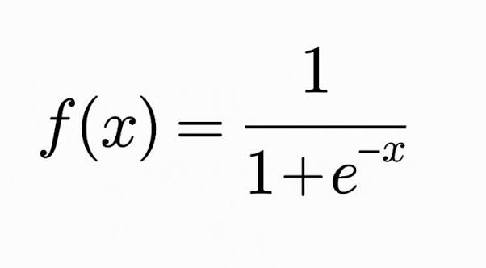
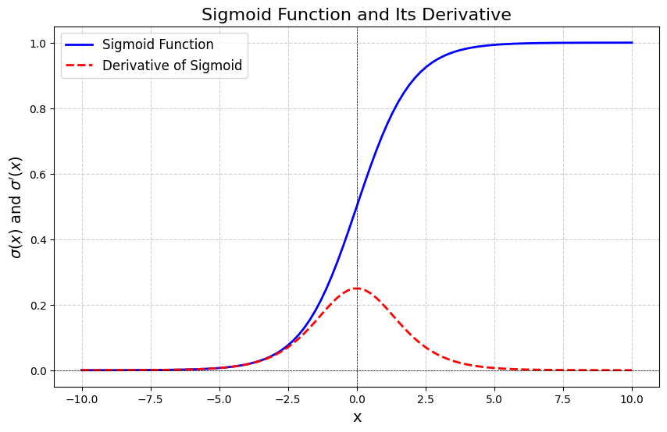
Sigmoid
Black Box

Slide 20
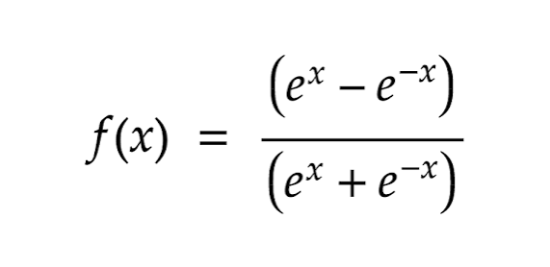
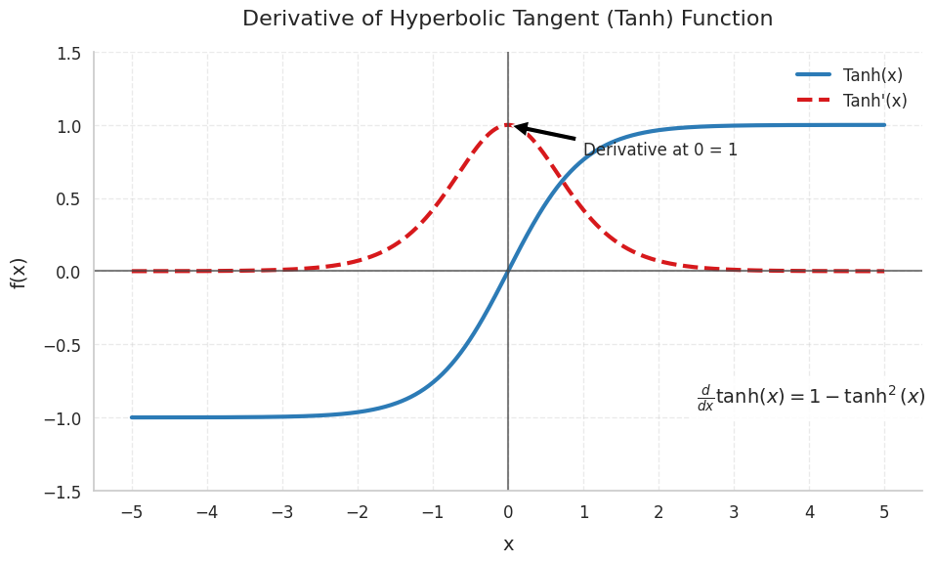
Tanh
Black Box

Slide 21
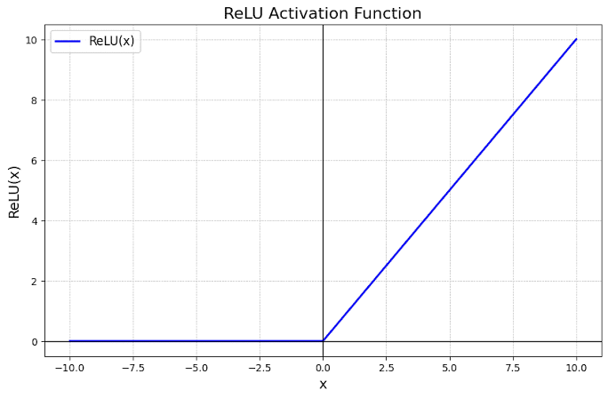
ReLU
f(x) = max(0, x)
Black Box

Slide 22
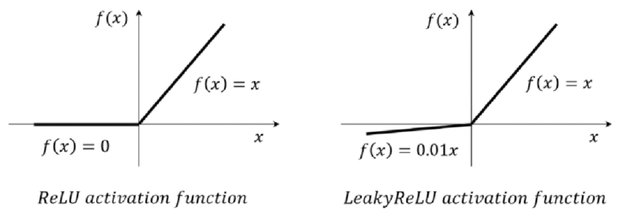
Leaky-ReLU
f(x) = max(αx, x)
α is often 0.01
Black Box

Slide 23

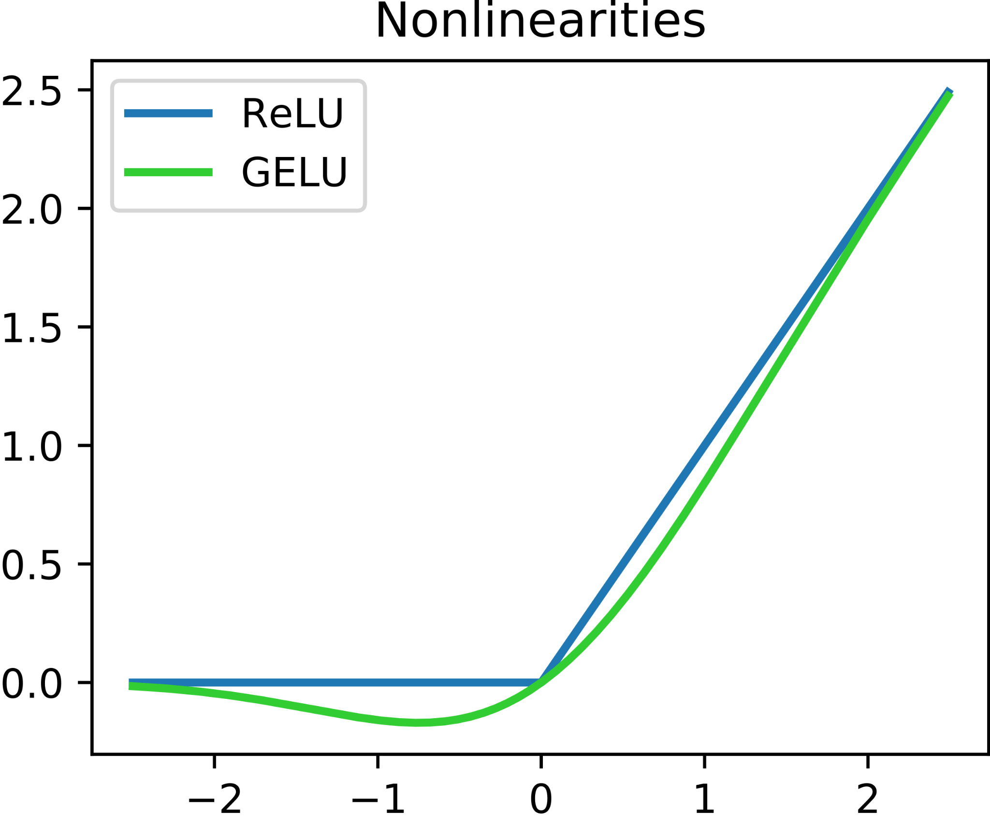
GeLU
Black Box

Slide 24
How is a Neural Network Trained
To train a neural Network, You need to:
Specify the task
Gather a huge amount of data for the task
Build your Neural Network
Pick a suitable Loss Function
Perform Forward Pass
Perform Backpropagation to compute a gradient for each parameter
Update parameters
Repeat the process for a number of epochs or based on some stopping criterion
Weights are updated using a Learning Rate

Slide 25
What is a Loss Function?
A loss function is the criteria that tells the model, how wrong its output is, according to the given task.
A big loss value indicates that the model performs poorly, a low value indicates that the model performs better
While Training Neural Network, You aim to reduce the loss value

Slide 26
What is a Loss Function?
Loss functions are task specific.
Regression tasks use Mean Square Error MSE
Classification Tasks use Cross-Entropy
Image Generation models use KL-Divergence [out of scope]
Other countless losses
You can use multiple loss functions to train a single network
Black Box

Slide 27
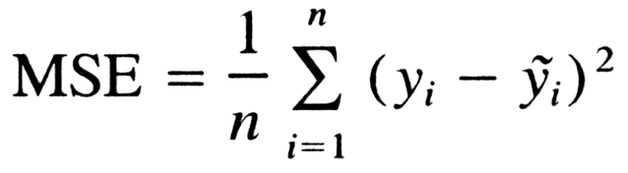
Regression
Regression is the task of predicting a continuous variable
Ex:
  House Pricing
  Object Localization (predicting coordinates)
Regression tasks aim to reduce Mean Squared Error (MSE).
Black Box

Slide 28
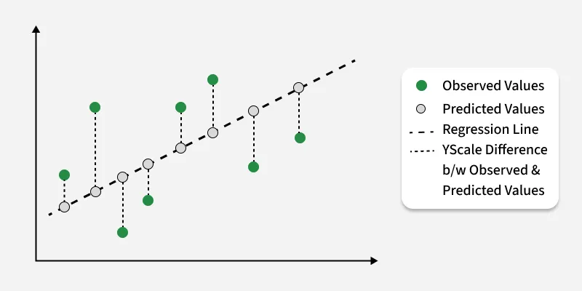
Mean Squared Error

Slide 29
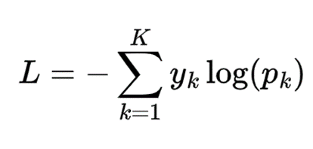
Classification
Classification is a task of choosing a class out of finite discrete classes.
Ex:
  Cat vs Dog Classification
Classification tasks aim to reduce the Cross Entropy loss
It aims to make the model’s output probability distribution match the true distribution

Slide 30
Cross Entropy
Ex:
Ground truth (y) = [0, 1, 0]
Predictions (p) = [0.01, 0.9, 0.09]
L = -0*ln(0.01)-1*ln(0.9)-0*ln(0.09)
L = 0.1
Ground Truth = [0, 0, 1]
Predictions = [0.01, 0.9, 0.09]
L = -0*ln(0.01)-0*ln(0.9)-1*ln(0.09)
L = 2.41

Slide 31
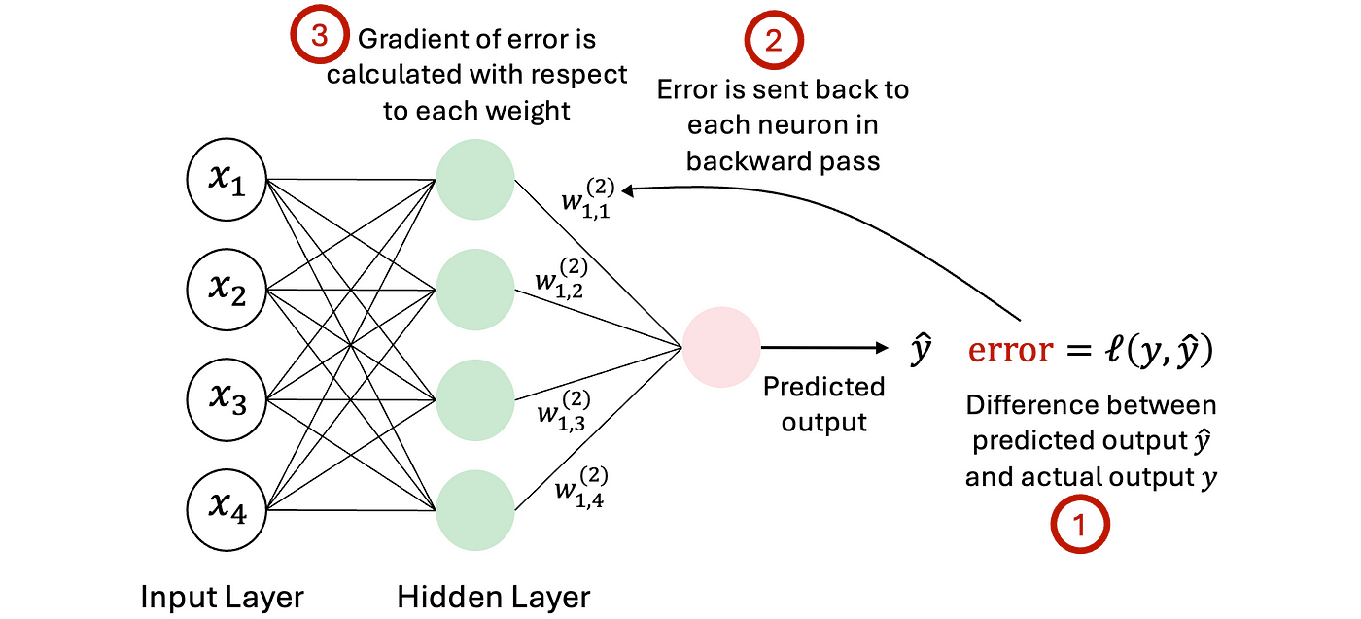
Backpropagation: The Core engine behind Neural Networks
Notes:
بشوف ايه الاتجاه الي لو الويت دا اتحرك نحيته, اللوس هيبقى اعلى
انت ممكن تستغرب , ليه عايز ازوده

Slide 32
What’s a gradient
Gradients tell you two pieces of information:
The steepness of the loss curve at the weight’s current position.
The direction you should walk toward to increase the loss.

Slide 33
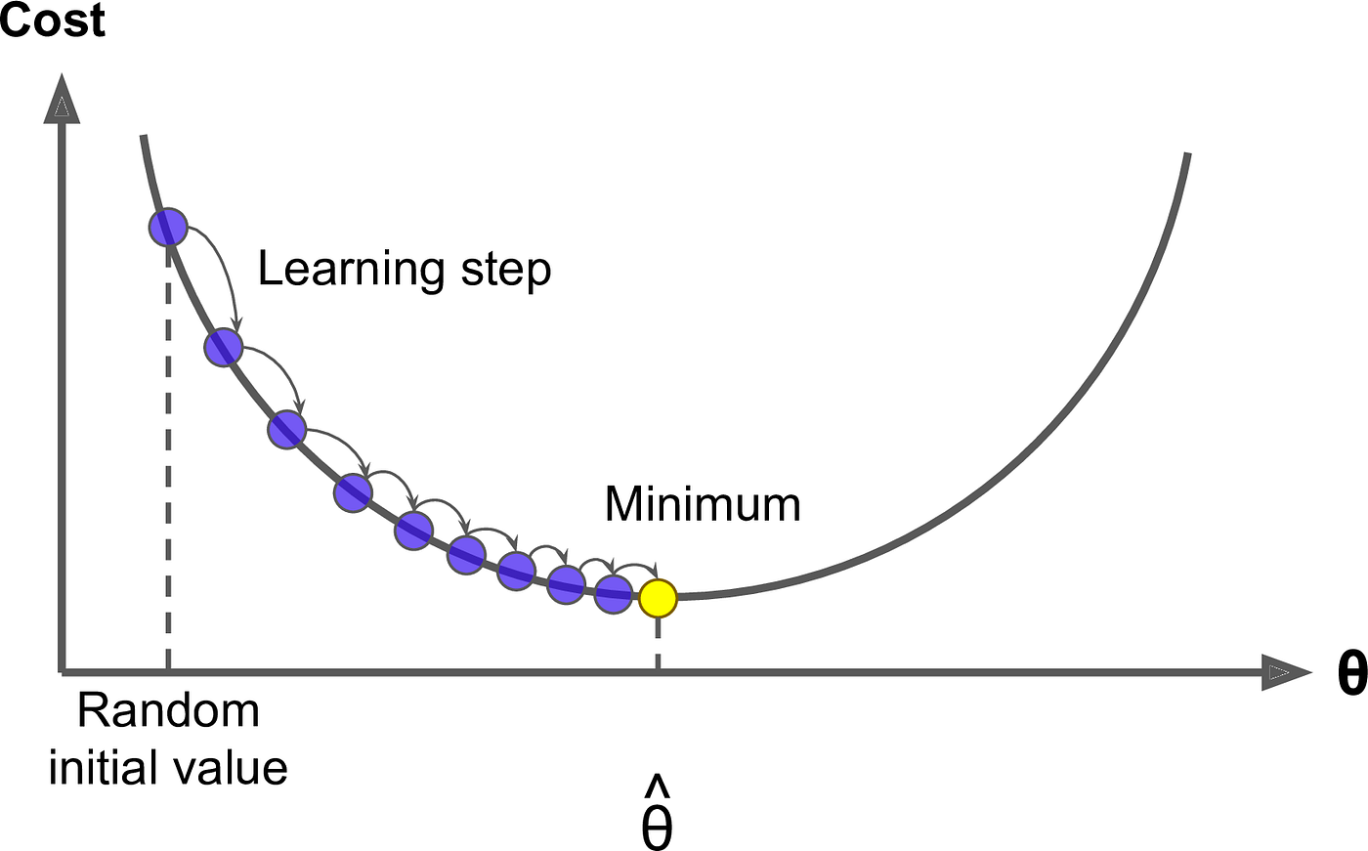
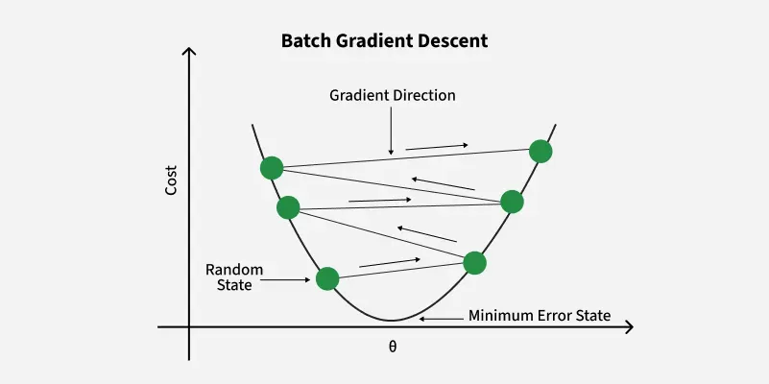
Backpropagation: The Core engine behind Neural Networks
Notes:
بشوف ايه الاتجاه الي لو الويت دا اتحرك نحيته, اللوس هيبقى اعلى
انت ممكن تستغرب , ليه عايز ازوده

Slide 34
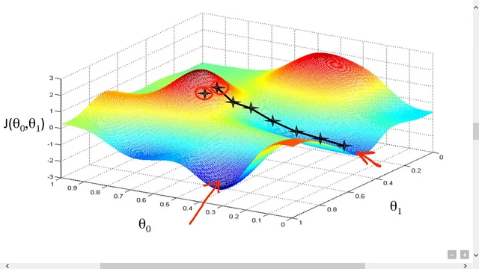
Backpropagation: The Core engine behind Neural Networks
Notes:
بشوف ايه الاتجاه الي لو الويت دا اتحرك نحيته, اللوس هيبقى اعلى
انت ممكن تستغرب , ليه عايز ازوده

Slide 35
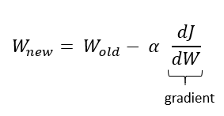
Update the weights
Update the weight by walking to the direction with a scaled step opposite to the direction that increases the loss
The scaling factor α is called a learning rate.
It controls how fast the network converges
Though it has to be set carefully since a low learning rate may cause the network to take a really long time to converge and a high learning rate may cause it to never converge [diverge]
Black Box

Slide 36
Common neural network training problems
Vanishing Gradients -> gradients get progressively small [especially the deeper the network goes] which causes it to converge really really slowly or maybe even never converge [can be alleviated by using different activation functions, though never exterminated]
Exploding Gradients -> gradients becomes larger, which causes the network to diverge rather than converge [can be alleviated by gradients clipping, though never exterminated]
One solution that addresses both problems is batch normalization, more on that later
Black Box

Slide 37
Putting it all together.

Slide 38
Convolutional Neural Networks
Motivation:
Why do we use CNNs? Why not use vanilla neural networks to process an image

Slide 39
Convolutional Neural Networks
2 good reasons:
NNs ignore the spatial structure of the image [no real understanding], although it (may) end up performing a bit good.
  Think of it as an unordered sentence
It requires an enormous amount of parameters to process a small image

Slide 40
Convolutional Neural Networks
Imagine having a 224x224x3 image, that’s too small for an image, but large enough for an NN.
224x224x3 = 150,528 pixels/inputs
Let’s say the first layer in the NN 1000 neurons
That gives you 150,528*1000 = 150,528,000 parameters only in the first layer
Although 1000 is considerably low for an input of that size, you’re basically compressing it and losing loads of information very early in the NN.

Slide 41
Convolutional Neural Networks
CNNs offered a much more efficient and meaningful solution.
They utilize convolution operators rather than simple layers of neurons.

Slide 42
Convolutional Neural Networks
CNNs offered a much more efficient and meaningful solution.
They utilize convolution operators rather than simple layers of neurons.

Slide 43
But, what is convolution?
Convolution is an operation where a small matrix called a filter/kernel slides across an input and computes a value at each location.
The ideas of convolution and correlation originated in the field of Signal Processing, but was later utilized in Image Processing and neural networks.

Slide 44
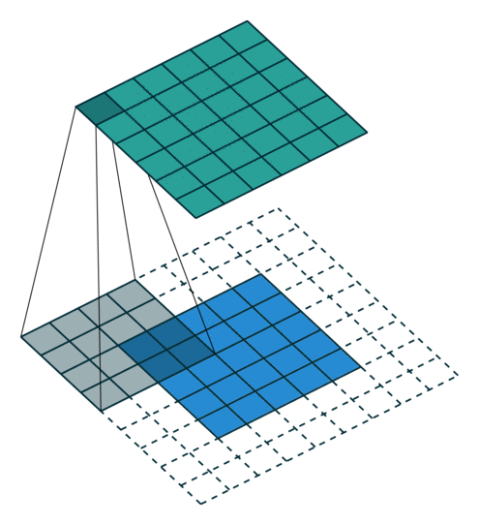
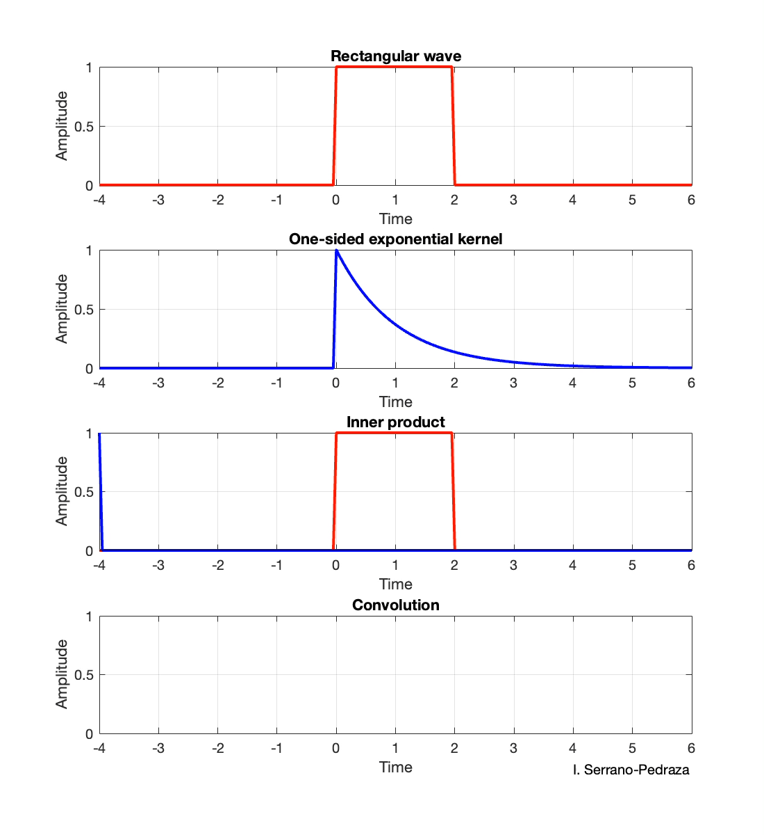
But, what is convolution?

Slide 45
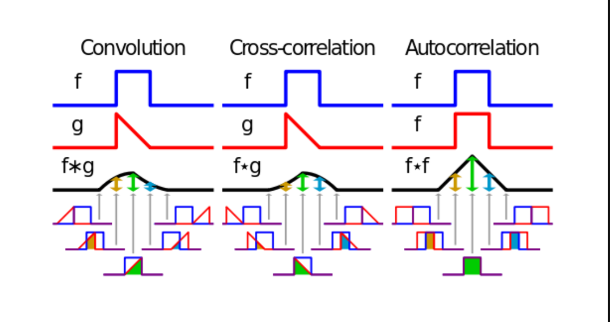
But, what is convolution?

Slide 46
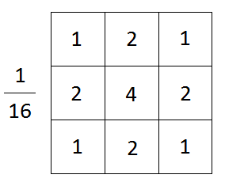
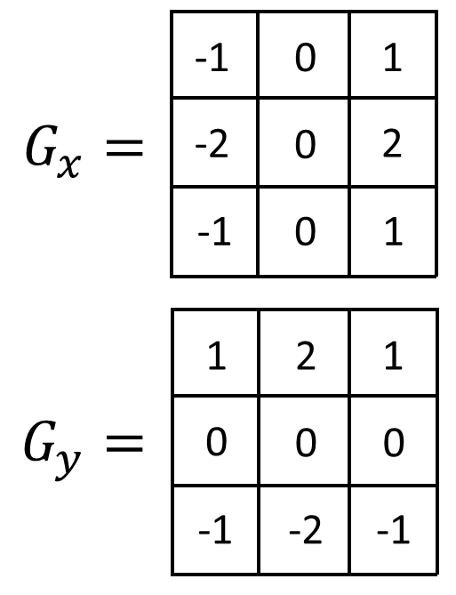
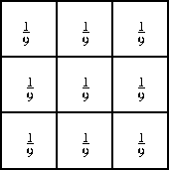
Here’s what a convolution may look like
Average filter
Gaussian Filter
(looks like a gaussian)
Sobel Filter

Slide 47
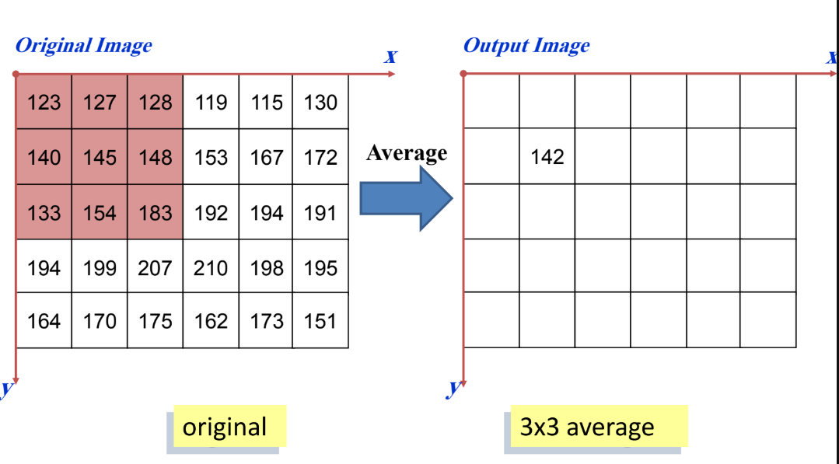
Applications of Convolution in Image Processing

Slide 48
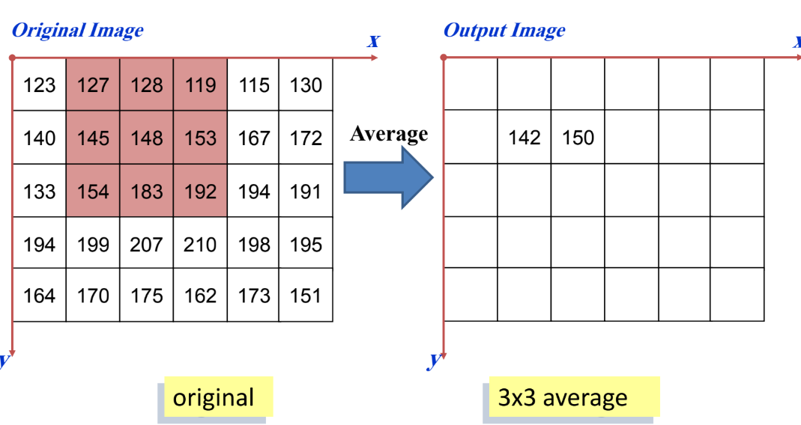
Applications of Convolution in Image Processing

Slide 49
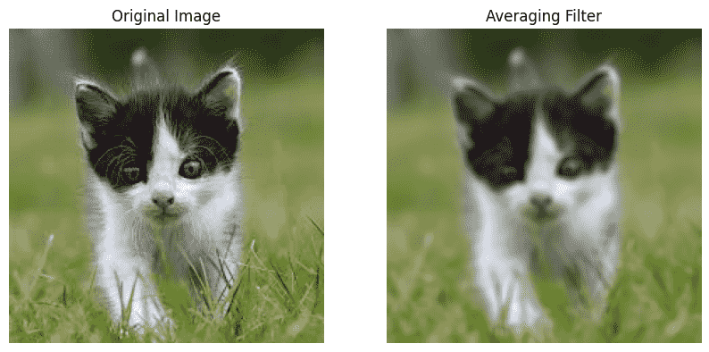
Average filter effect

Slide 50
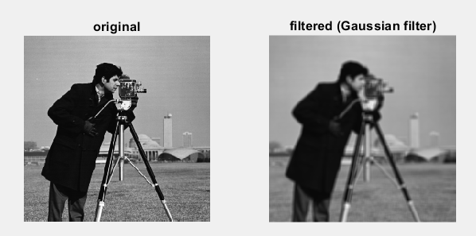
Gaussian filter effect

Slide 51
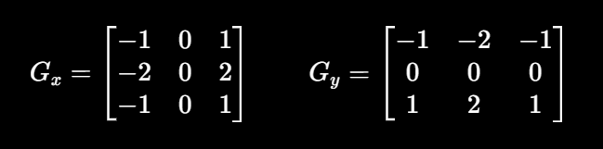
Edge Detectors
Sobel Edge Detector

Slide 52
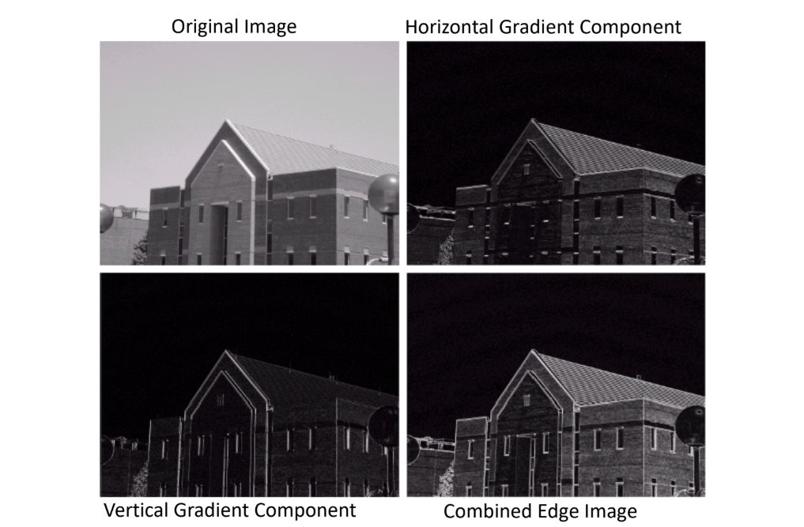
Edge Detectors

Slide 53
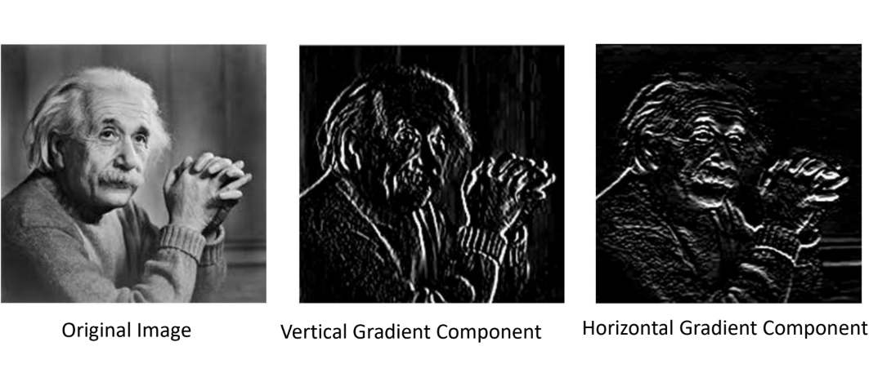
Edge Detectors

Slide 54
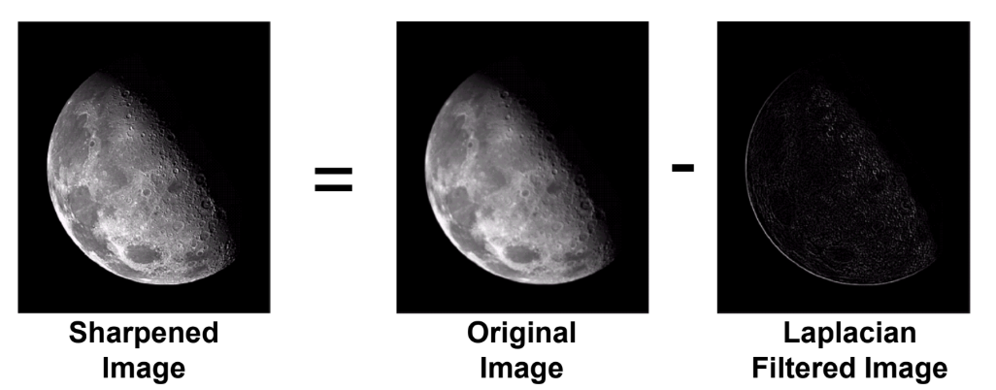
Image Sharpenning

Slide 55
Image Sharpenning
Countless Other Filters

Slide 56
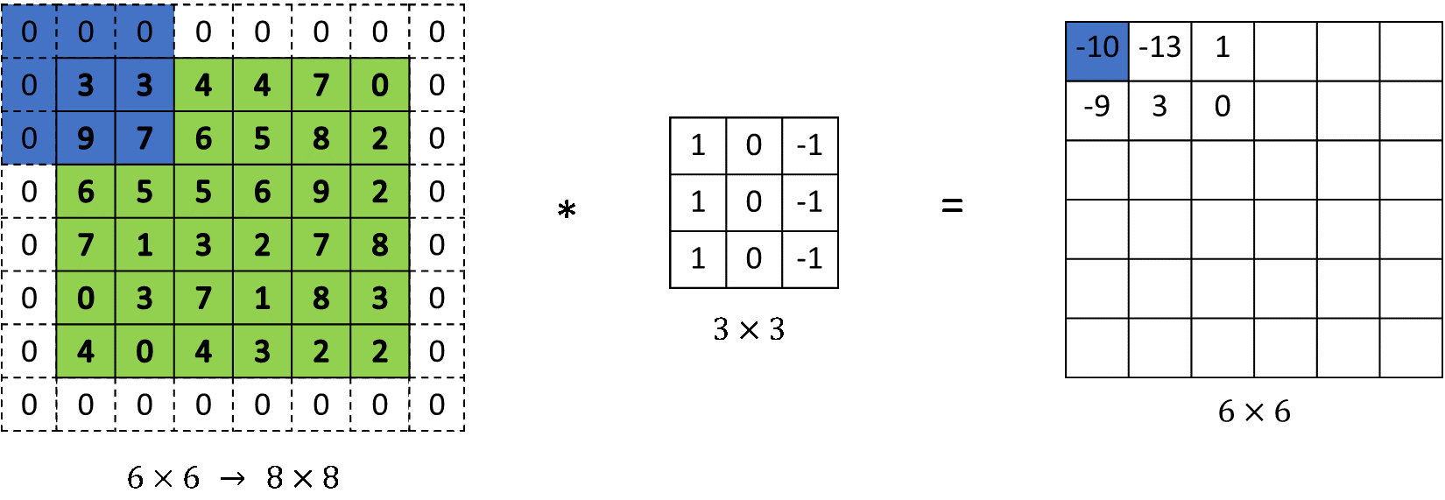
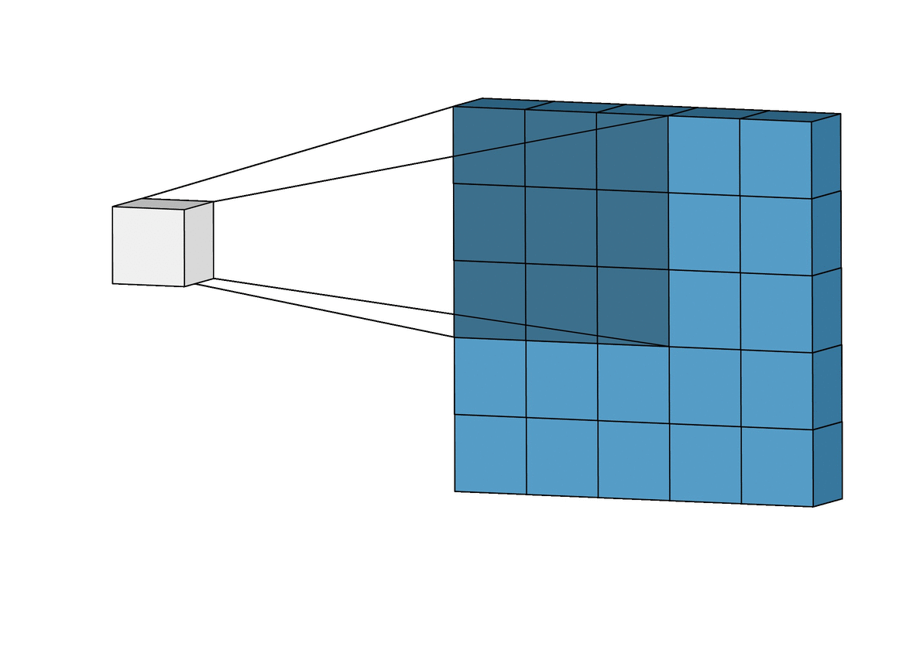
Convolution main parameters
Kernel Size -> sets the dimensions of the kernel (typically 3)
Padding ->sets the padding around the image to avoid input/output dimension change. In other words, preserves the input size.
Stride -> how many steps horizontal/vertical should the filter move (typically 1)

Slide 57
Back to CNNs
Ok, cool , but what does any of that have to do with CNNs.
CNNs use the convolution operators to extract features from input images
But which kernel does it use to extract feature, is it sobel? Gaussian? Averaging?

Slide 58
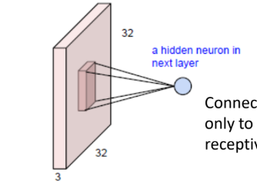
Back to CNNs
It uses none of these, it learns ITS OWN set of filters
You can think of each entry in a filter matrix as a parameter, and the output of a filter applied to a region within the image, as a neuron
Except, CNNs filters take the depth of the image into account too.

Slide 59
Back to CNNs
Convolution solves the problems caused by applying vanilla NNs on images.
Has spatial awareness
Significantly reduces the number of parameters

Slide 60
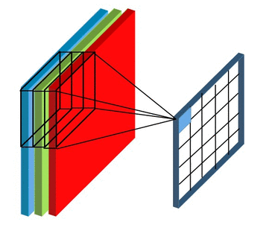
Back to CNNs

Slide 61
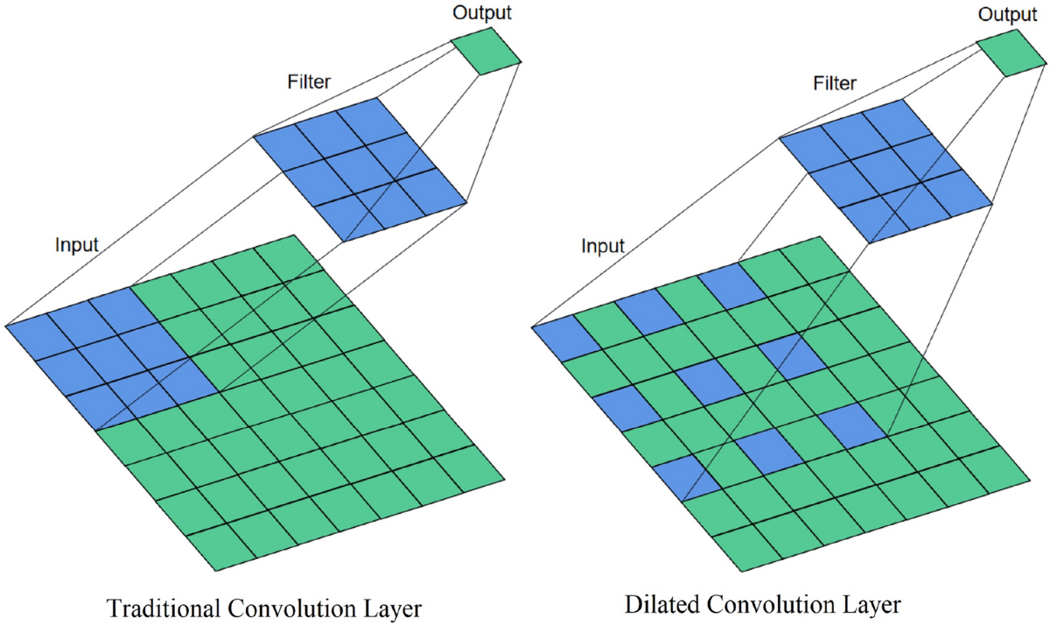
Convolution layer main parameters
All parameters of convolution
Number of filters -> sets the number of filters per layer
Dilation -> (typically unchanged, default 1)

Slide 62
Back to CNNs
A CNN, typically consists of multiple convolution layers, each layer consists of N convolution filters, Activation functions, as well as Pooling Layers.
The output of each convolution layer is called a feature map

Slide 63
Activation Functions in CNNs
The most commonly used activation function in CNNs is ReLU

Slide 64
Pooling
Pooling is a technique used to Reduce the size of the feature maps after one or more convolution steps to allow the network to focus on more important features
It works exactly the same way convolution works in terms of having a moving kernel over an image.
Usually strided
There are 2 common Pooling types:
  Max Pooling
  Average Pooling [basically, the average filter we discussed earlier]

Slide 65
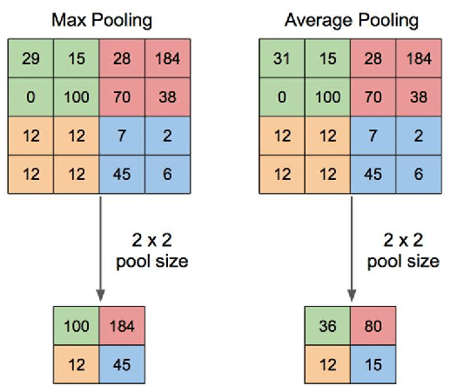
Pooling

Slide 66
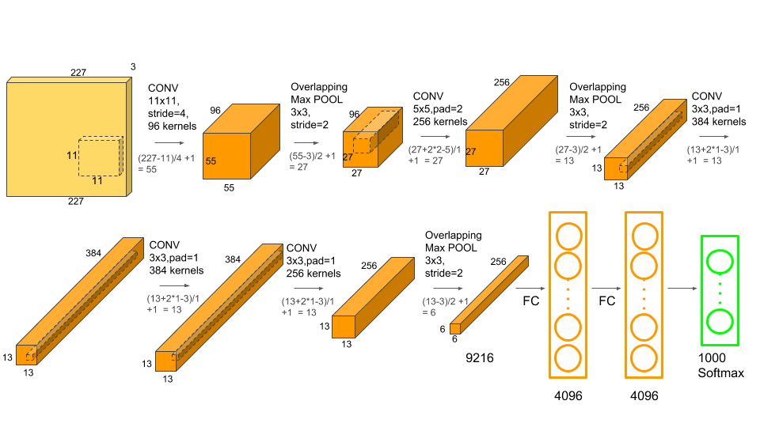
Back to CNNs

Slide 67
Feature Maps Flattening
After the final layers of a convolution network, the feature maps are flattened.
Flattened feature maps are passed to an MLP [vanilla NN] to pass information to each other and get enriched with more information
Finally, the output of the MLP is passed to a classification/regression head to give the final output.

Slide 68
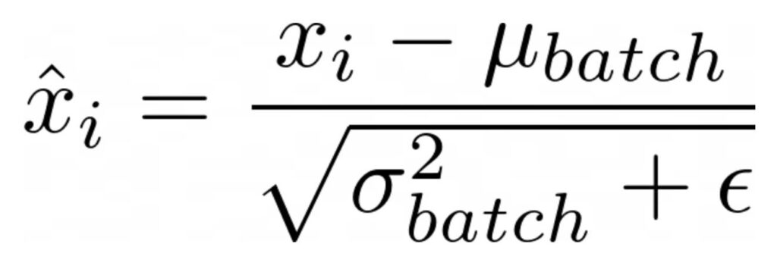
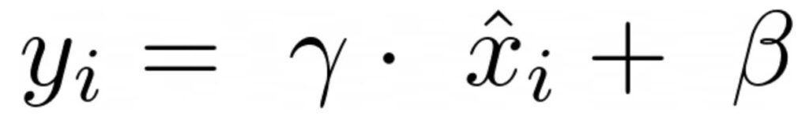
Batch Normalization
Batch Normalization normalizes the weights of each layer to avoid vanishing gradients, exploding gradients as well as a problem called “covariate shift”
It does that by shifting by the mean and scaling by the SD, but it also keeps a room for inverse transform if the network thinks that this isn’t the optimal step [Gamma and Beta]
This helps stabilizing the training, converging in a lower number of epochs and allows you to pick higher learning rates for your network
During inference, there are no batches [or there might be], therefore, the network uses the running mean [regardless]

Slide 69
The common order of the previous layers
Conv -> BatchNorm -> ReLU -> Pool

Slide 70
Image Augmentation
Augmentation is a method used to artificially increase the number of training samples.
This process reduces overfitting and allows the model to see more diverse images during training, which results in a better generalization

Slide 71
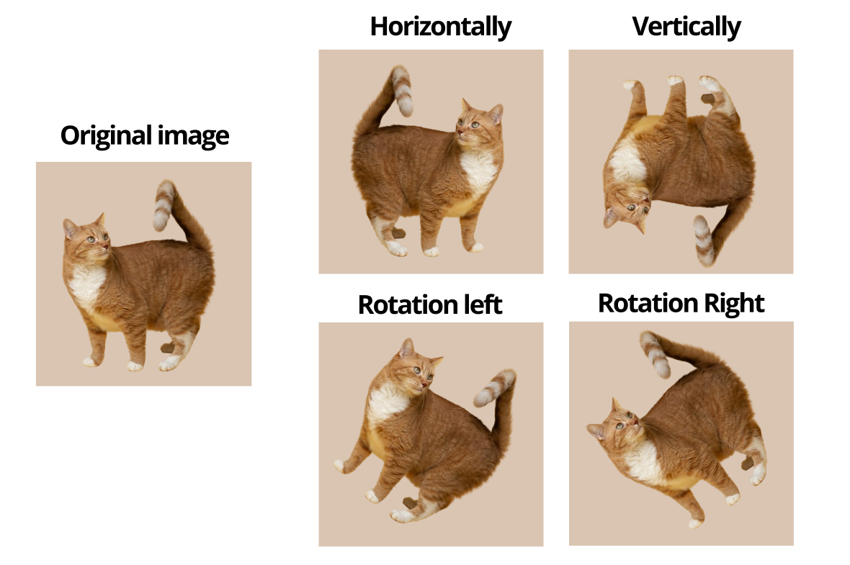
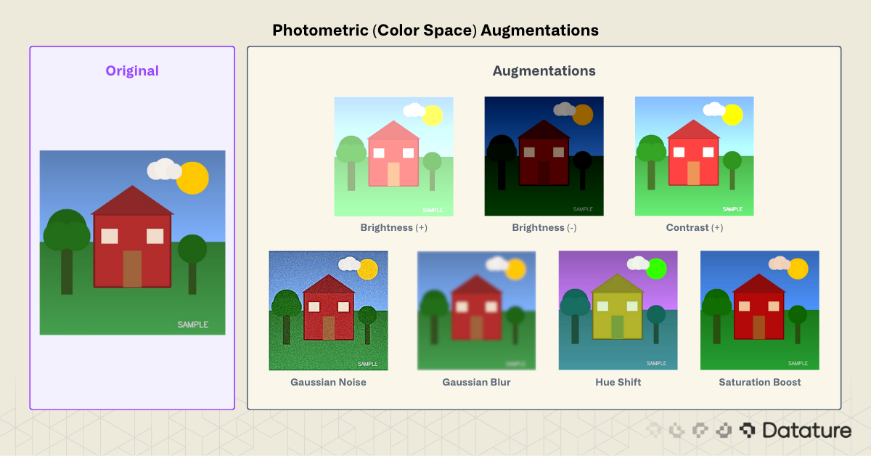
Image Augmentation

Slide 72
Training, Validation and evaluation for image classification
You typically split your dataset into 3 subsets:
Training set
Validation set -> guides the training process
Test set -> final evaluation for the model
Sometimes we just use the validation set as a test set for experimentation purposes, though in real projects, you need a dedicated test set
Common splits are 0.7, 0.15, 0.15 or 0.7, 0.2, 0.1

Slide 73
ImageNet1k
A large-scale image dataset created for visual object recognition research.
Contains millions of labeled images organized into thousands of object categories.
Its most famous subset is ImageNet-1K:
~1.2 million training images
1,000 classes
It powered the ImageNet Large Scale Visual Recognition Challenge (ILSVRC), which drove major advances in CNNs.

Slide 74
ImageNet1k
1.28M training images
50K validation images
100K test images (labels historically withheld for the challenge)

Slide 75
Evaluation
For evaluation, we usually categorize predictions into 4 categories:
[this especially makes more sense in binary classification tasks]
True Positive TP: the sample belongs to the positive class, and the model does predict a positive class
False Positive FP: the sample belongs to some the negative class but the model relates it to the positive class
True Negative TN: The sample belongs to the negative class, and the model successfully relates it to the negative class
False Negative FN: the sample belongs to the positive class, but the model relates it to the positive class

Slide 76
Evaluation
For evaluation, we usually use 3 main metrics
Accuracy: how many samples did the model actually classify correctly across all samples regardless the class
Precision:
How often is the model correct when it picks this class
In other words: Correct predictions of class X / All predictions labeled as class X
TP/(TP+FN)
Recall:
  Out of all actual samples of class X, how many did we classify correctly?
  TP/(TP+FP)

Slide 77
Example to distinguish between Precision and Recall
There are 10 actual cats, but the model predicts 8 cats:
6 predictions are actually cats → TP = 6
2 predicted cats are dogs → FP = 2
4 actual cats were missed → FN = 4
Recall: 6/10=60% → Of real cats, found 60%.
Precision: 6/8=75% → Of predicted cats, 75% were actually cats.

Slide 78
Thanks for your attention
Break then Lab

Slide 79
Thanks for your attention

Slide 80
Neural Networks

